Slide 1
Predicting the Likelihood of Readmission for Diabetic Patients.
Boma Obeahon

Slide 2
Introduction
Diabetes is a chronic condition affecting people of all ages and as of 2021, it was prevalent in about 38.4 million people in the U.S. The objective of this project is to predict the probability of a diabetic patient being readmitted. The results from this project will help hospitals design a follow-up protocol to ensure that patients having a higher re-admission probability are well monitored to better manage the ailment.
The dataset comprises of data spanning 10 years (1999-2008) of clinical care across 130 US hospitals. Attributes within the dataset include patient identifiers, demographic information (race, gender, age), admission details (time in hospital), number of lab tests performed, diagnoses, medication details, as well as the number of outpatient, inpatient, and emergency visits in the year prior to hospitalization, among others.

Slide 3
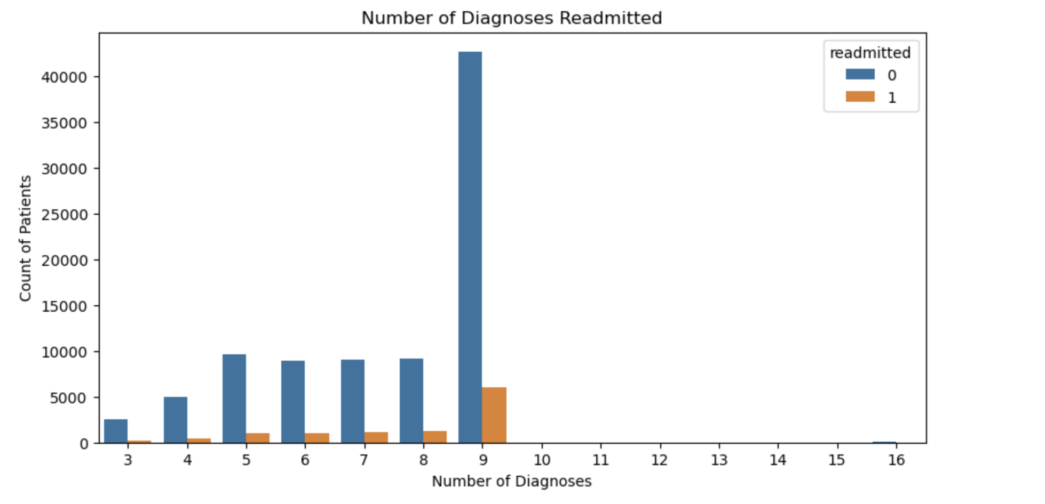
Number of Diagnoses Leading to Readmission

Slide 4
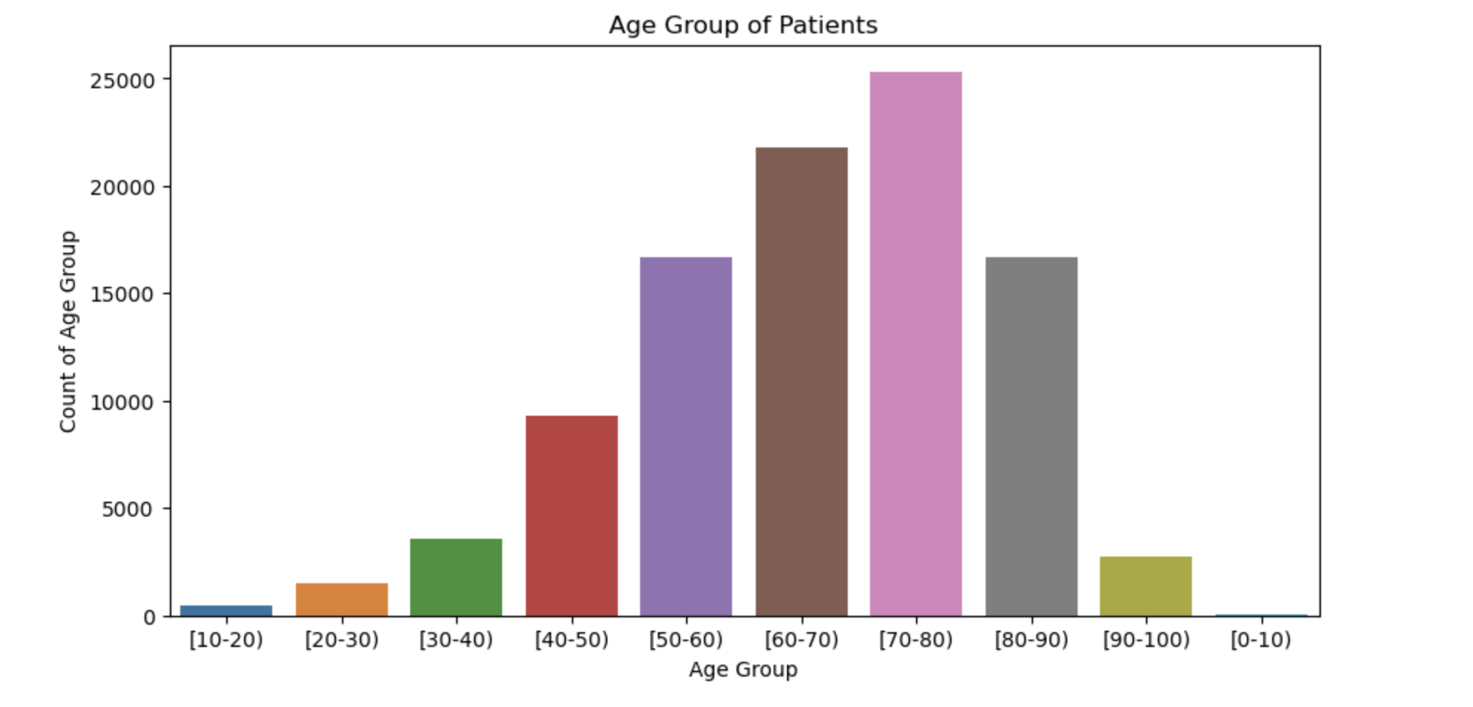
Age Group of Patients

Slide 5
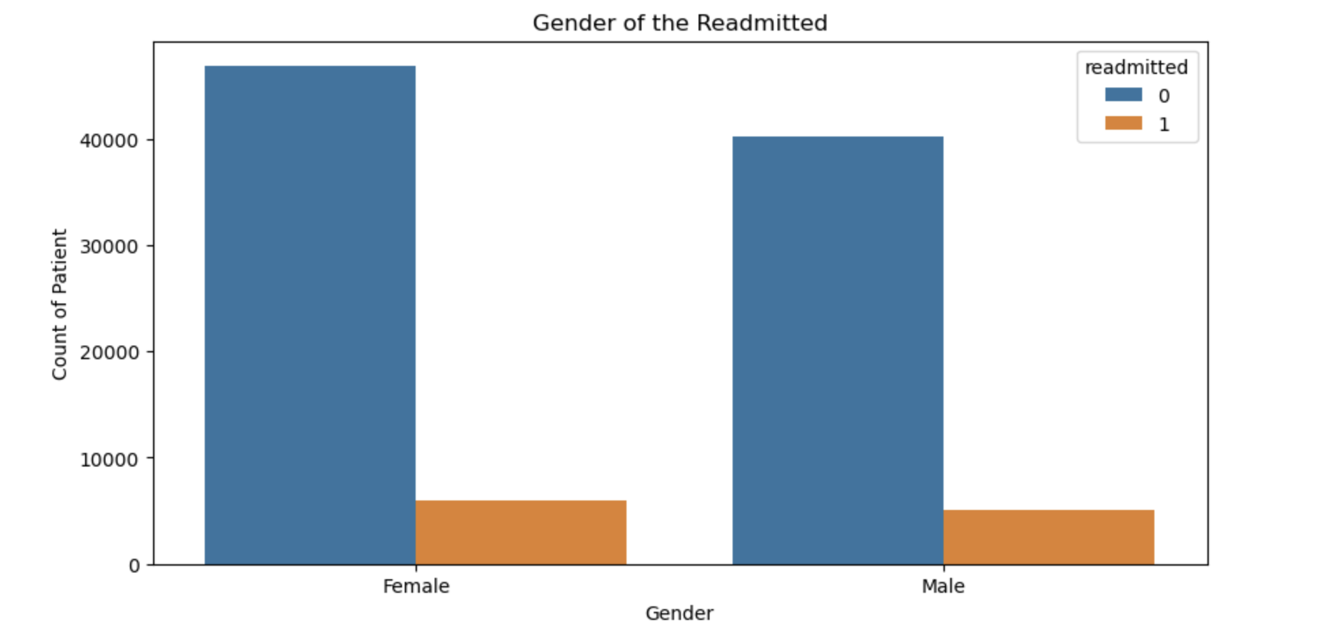
Gender of Readmitted Patients

Slide 6
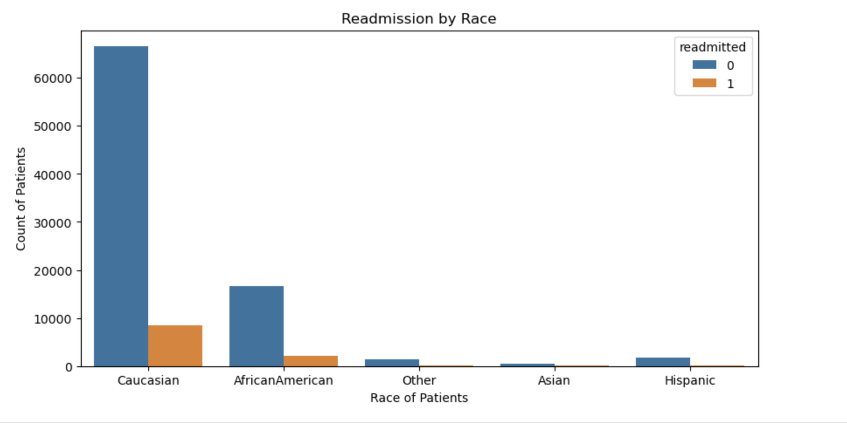
Race of Readmitted Patients

Slide 7
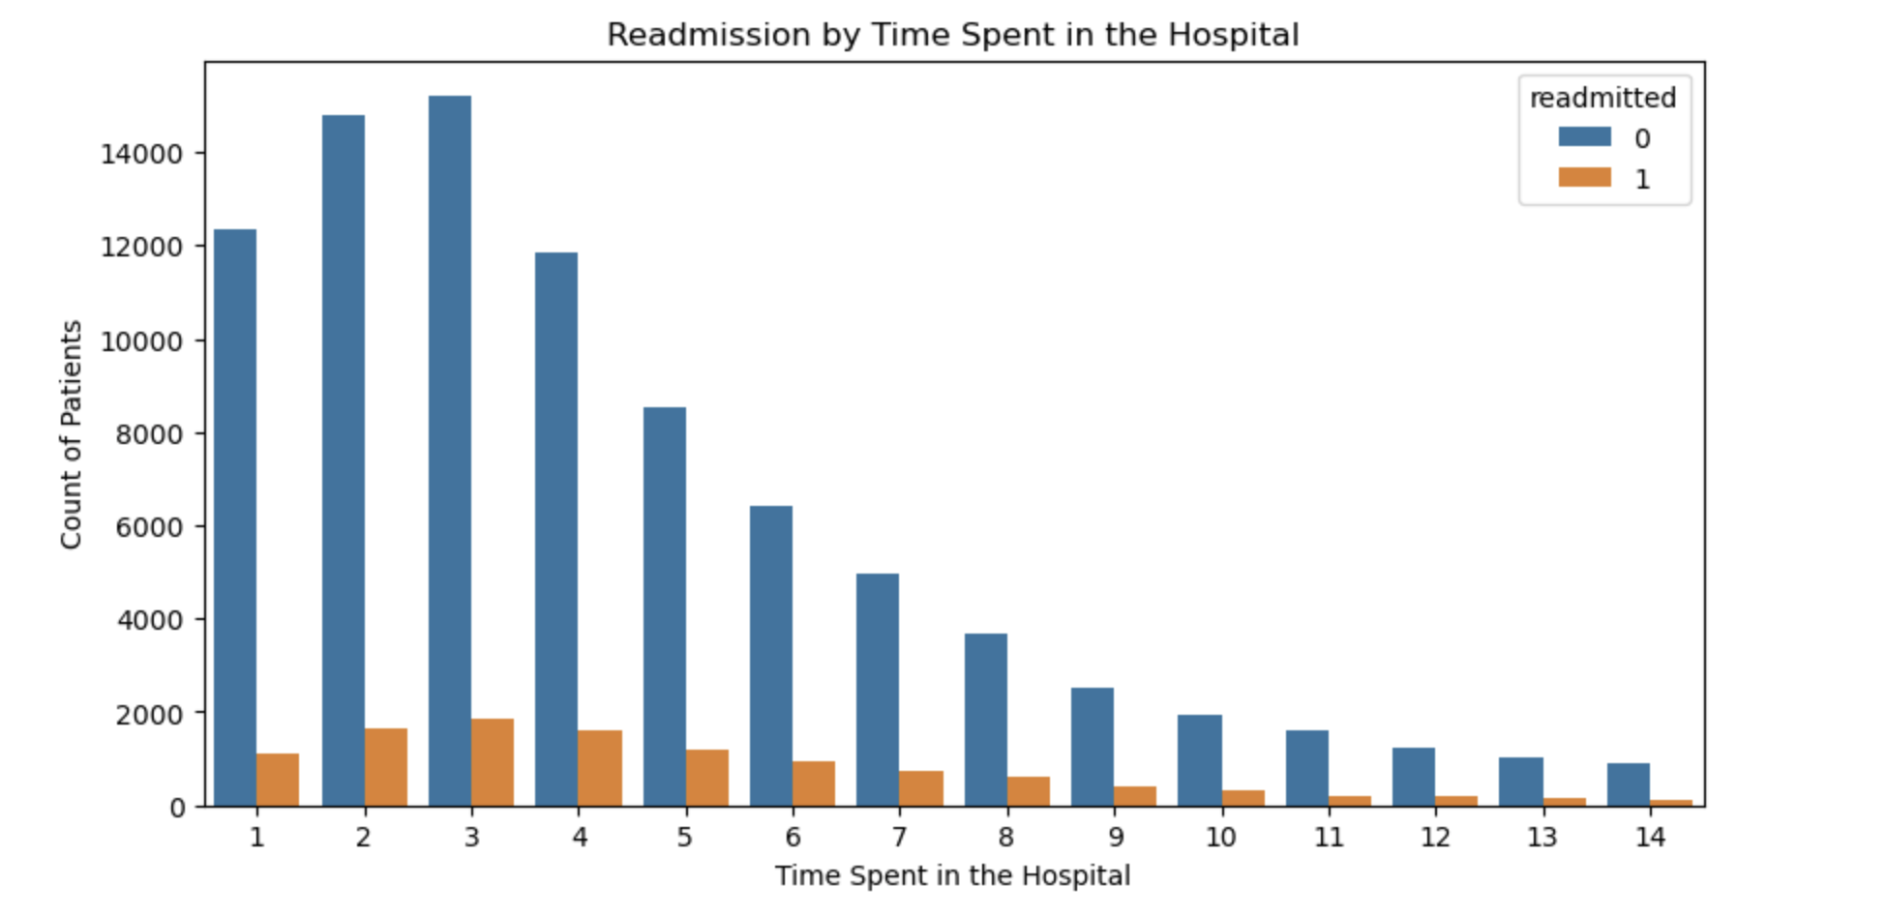
Time Spent in the Hospital Vs Readmission

Slide 8
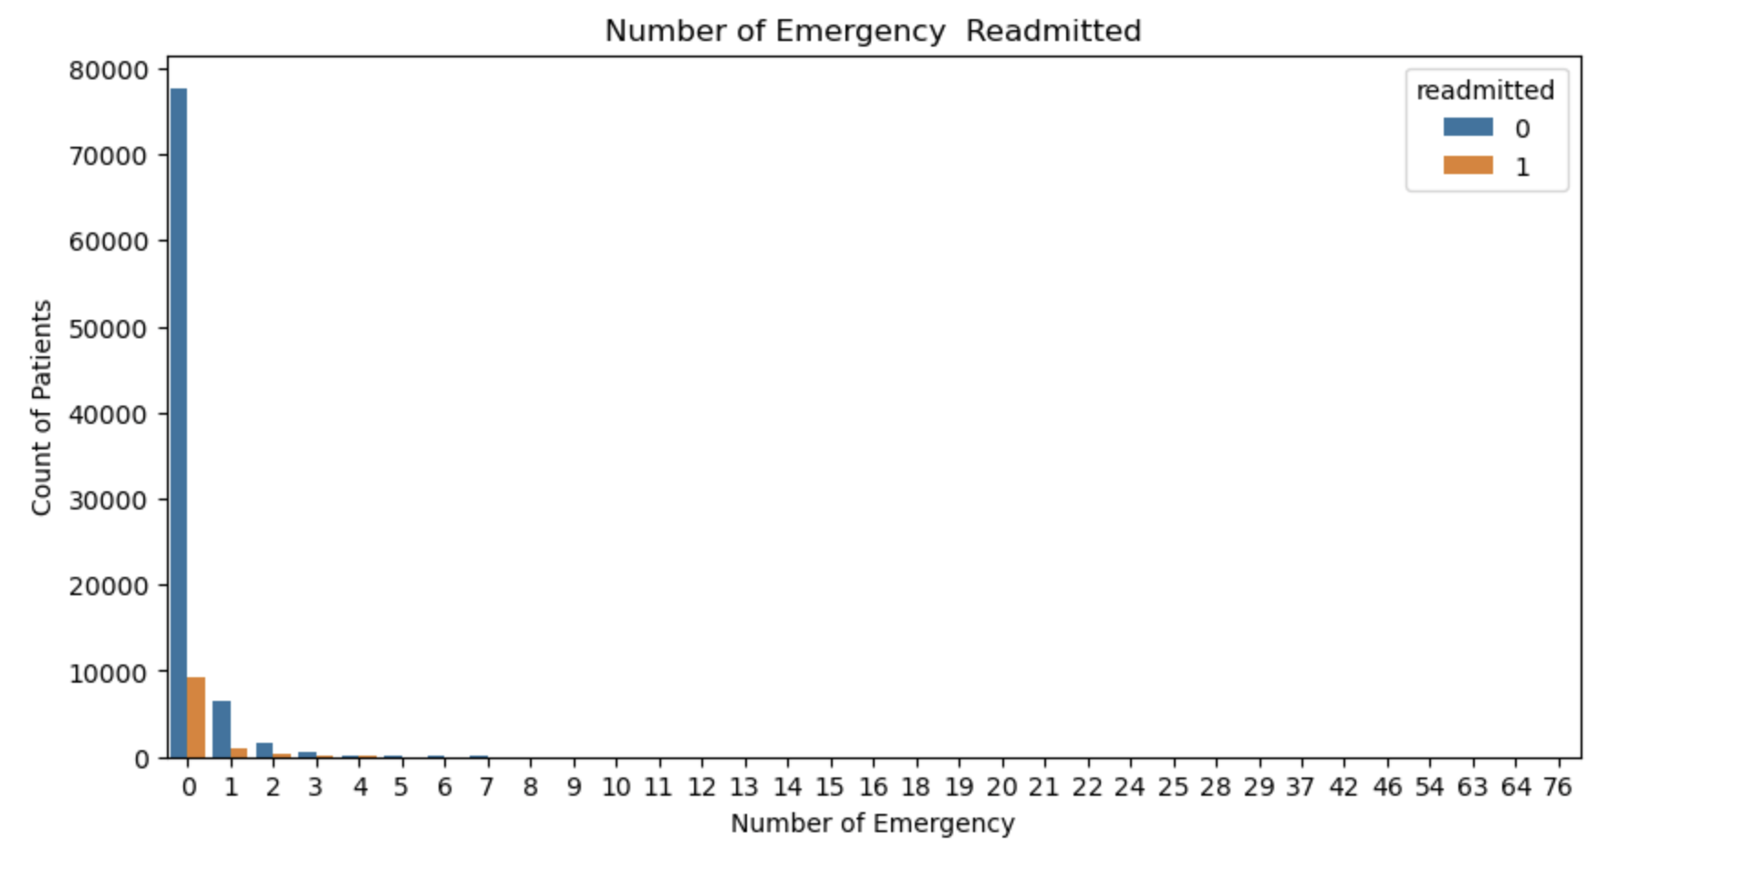
Number of Emergency Visits Vs Readmission

Slide 9
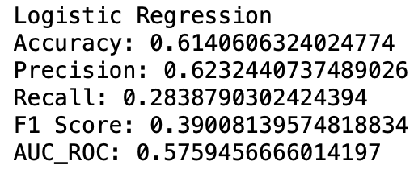
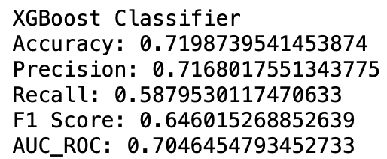
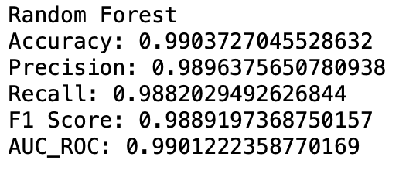
Model Building/Performance
Several classification algorithms/models were used;
Random Forest Classifier
Logistic Regression
KNeighborsClassifier
DecisionTreeClassifier
XGBoost Classifier
However, the Random Forest Algorithm emerged as the best model, demonstrating the following performance metrics:

Slide 10
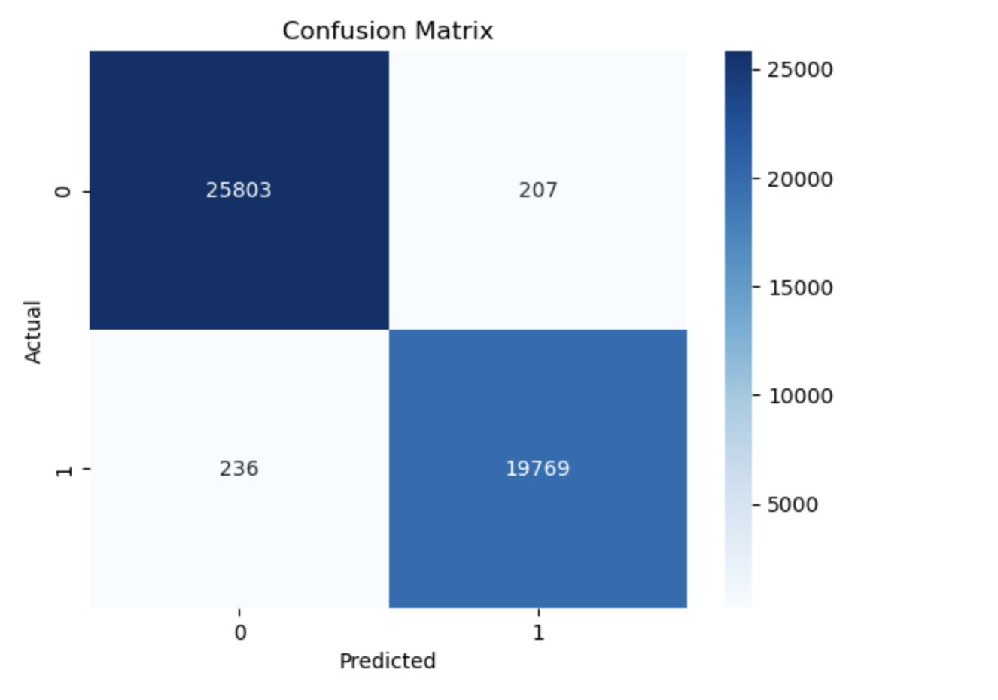
Random Forest Confusion Matrix

Slide 11
Conclusion
With the data provided by the patient, this model was able to predict the likelihood of readmission. This can help in the managing the ailment and reduce the number of relapses.
THANK YOU.

